Slide 1


SIMATS ENGINEERING
SAVEETHA INSTITUTE OF MEDICAL AND TECHNICAL SCIENCES
DataSync – Intelligent Client-Server Data Exchange Platform
CSA4315 – Internet Programming
Date : 27/10/2026 Batch : 04
Guided by:
Dr. Krishnaraj Mony
Associate Professor/CSE
Presented by:
192425298 – THURPINTI MAHADHEEP
192425051 – KOTHAMASU SATHWIK KUMAR
192425035 – CHADALAVADA S L V N NIKHILESH
192425210 – SYED SUHEL

Slide 2


INTRODUCTION
Data exchange everywhere: Modern web applications constantly exchange data between browsers, mobile clients, and servers for orders, messages, profiles, and live updates.
Stale and inconsistent data: Page reloads and manual refresh cause delayed updates, so users on different devices often see mismatched information.
Inefficient communication: Repeated polling and full-payload transfers waste bandwidth and increase server load and response time.
An intelligent platform: This project builds “DataSync”, a client-server platform that uses REST APIs, WebSockets, and JSON to keep data synchronized in real time.
Integrated web approach: The platform combines a responsive web client, a Node.js server, a database with caching, delta synchronization, and JWT-based secure access.

Slide 3
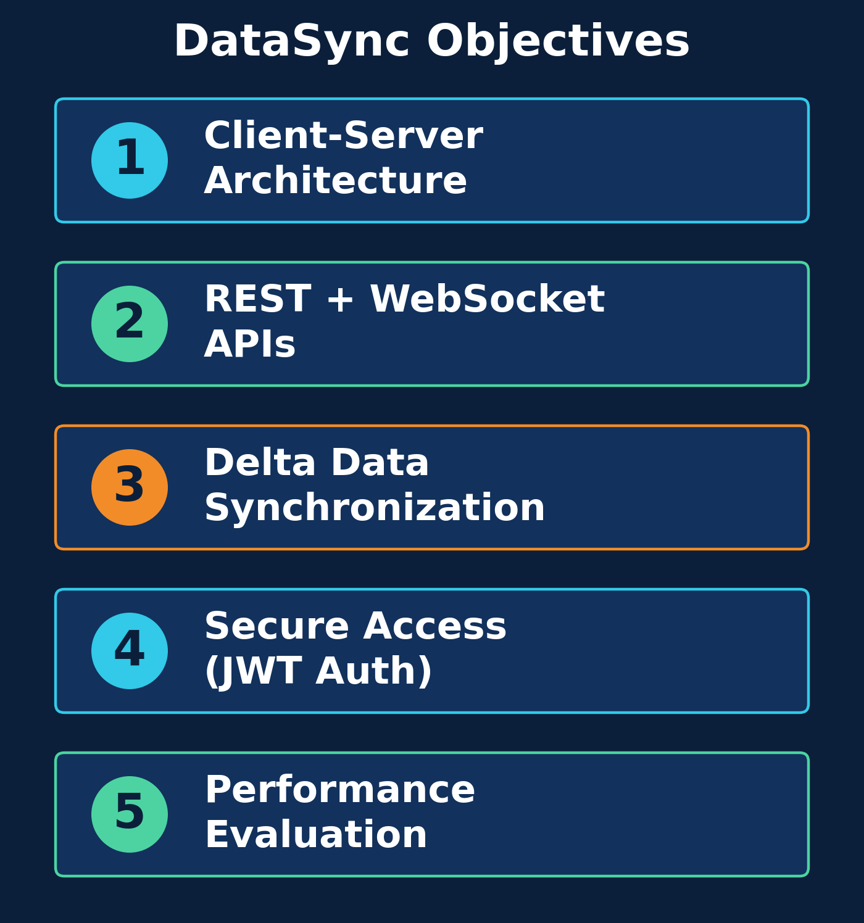
OBJECTIVES
Client-Server Architecture:Build a layered web platform where browser clients and a Node.js server exchange data.
REST & WebSocket APIs:Provide REST endpoints and WebSocket channels for instant JSON data updates.
Delta Synchronization:Send only changed records and resolve conflicts to keep all clients consistent.
Secure Data Exchange:Protect communication with JWT authentication, validation, and HTTPS/WSS.
Performance Evaluation:Measure response time, bandwidth, and server load against polling.

Slide 4
LITERATURE SURVEY
S.No | Title | Authors | Year | Techniques Used | Problem Addressed
1 | Architectural Styles and the Design of Network-based Software Architectures | R. T. Fielding | 2000 | REST Architectural Style | Need for a scalable, uniform interface for client-server web communication
2 | The WebSocket Protocol (RFC 6455) | I. Fette, A. Melnikov | 2011 | WebSocket, Full-Duplex Messaging | Latency and overhead of HTTP polling for real-time updates
3 | JSON Web Token (JWT) (RFC 7519) | M. Jones, J. Bradley, N. Sakimura | 2015 | JWT, Token-Based Authentication | Secure, stateless authentication of client requests
4 | Conflict-free Replicated Data Types | M. Shapiro, N. Preguiça, C. Baquero, M. Zawirski | 2011 | CRDTs, Eventual Consistency | Keeping replicated data consistent without central coordination
5 | A Conflict-Free Replicated JSON Datatype | M. Kleppmann, A. R. Beresford | 2017 | JSON CRDT, Concurrent Editing | Merging concurrent JSON updates from multiple clients

Slide 5
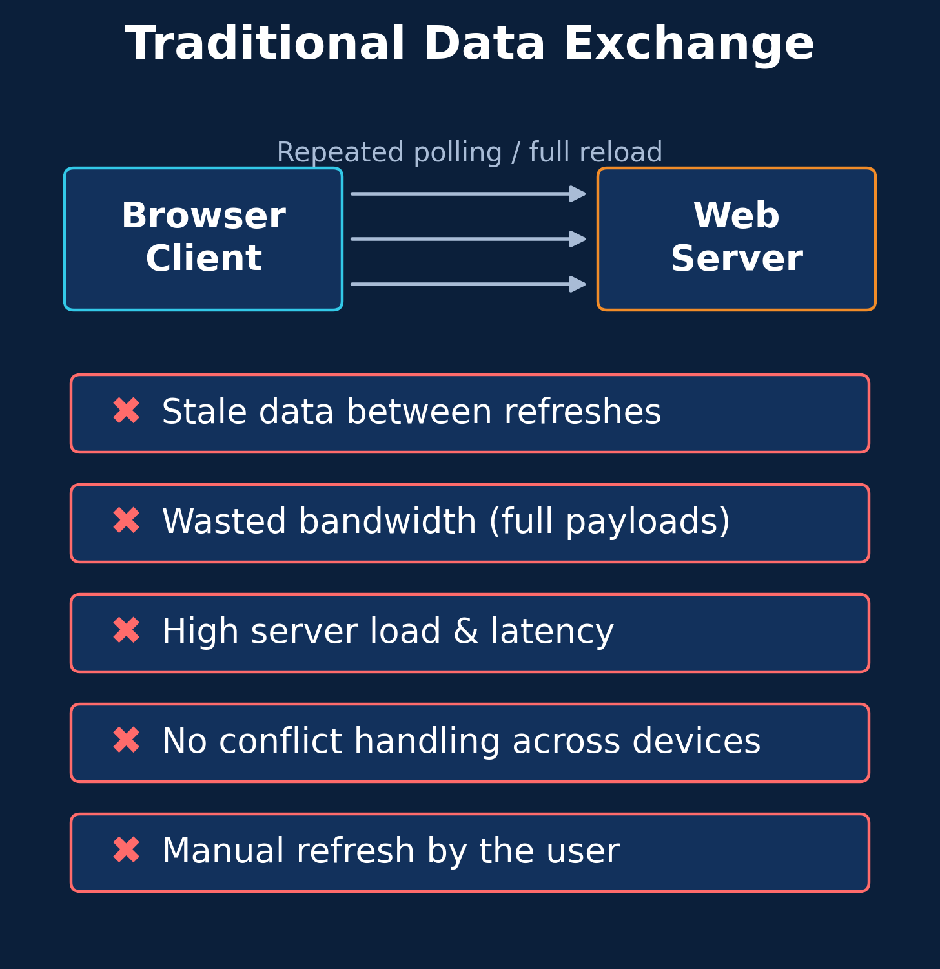
EXISTING SYSTEM
Periodic Polling: Clients repeatedly request data from the server at fixed intervals, even when nothing has changed.
Full Page Reloads: Updates require refreshing the page or downloading complete payloads instead of only the changed data.
Delayed Updates: Users see stale information between refresh cycles, and changes made on one device appear late on others.
No Conflict Handling: Simultaneous edits from multiple clients overwrite each other without any merge or conflict resolution.
Weak Efficiency & Security: Heavy bandwidth use, higher server load, and inconsistent authentication across data-exchange endpoints.

Slide 6
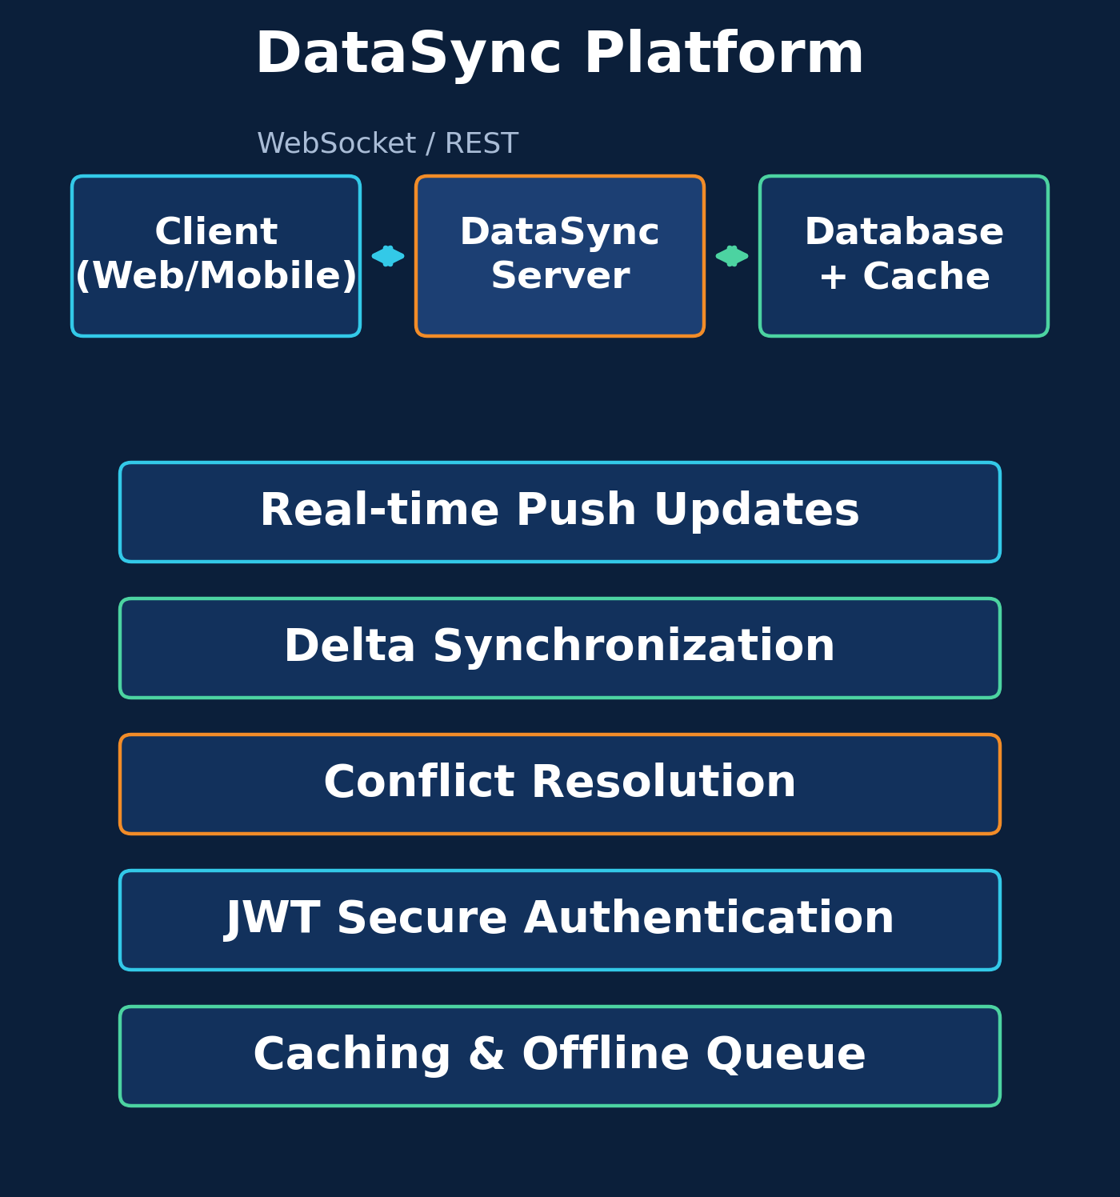
PROPOSED SYSTEM
Real-Time Data Exchange: Uses WebSockets and REST APIs to push updates instantly between clients and the server in JSON format.
Delta Synchronization Engine: Computes and transfers only the changed records, reducing bandwidth usage and response time.
Conflict Resolution Module: Detects simultaneous edits and merges them using version tracking to keep all clients consistent.
Secure Access Layer: Protects every request with JWT authentication, role-based access, input validation, and HTTPS/WSS.
Caching & Offline Queue: Caches frequent data and queues client changes during disconnection, syncing automatically on reconnect.

Slide 7
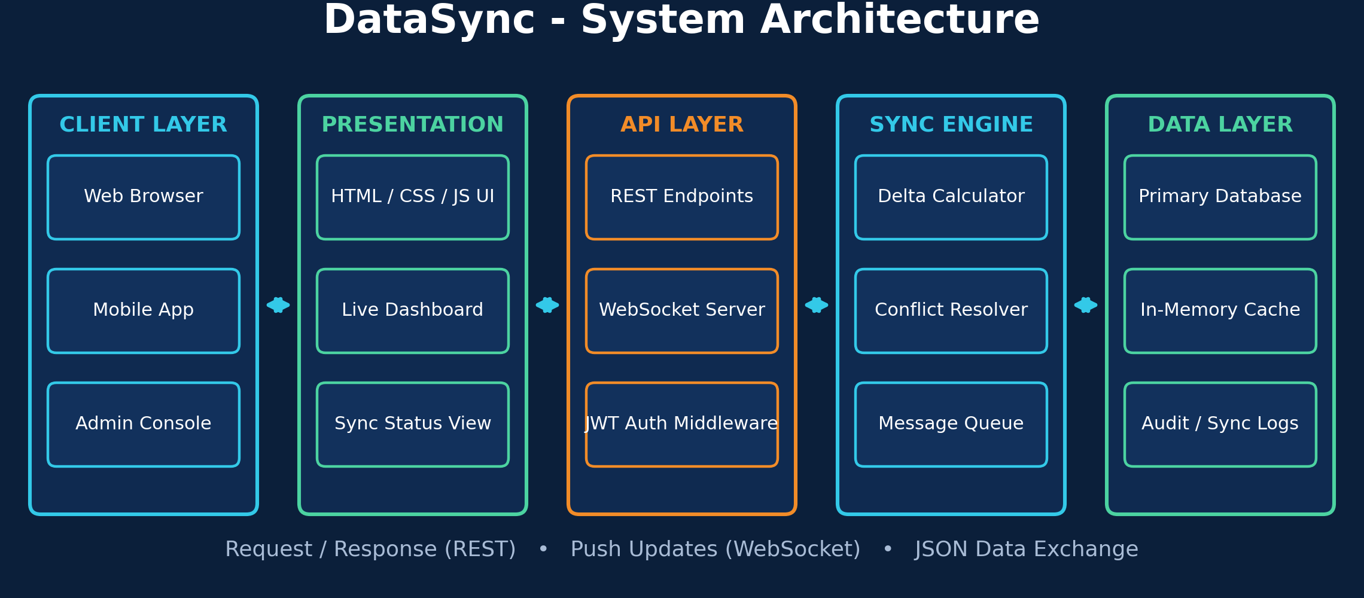
ARCHITECTURE DIAGRAM

Slide 8
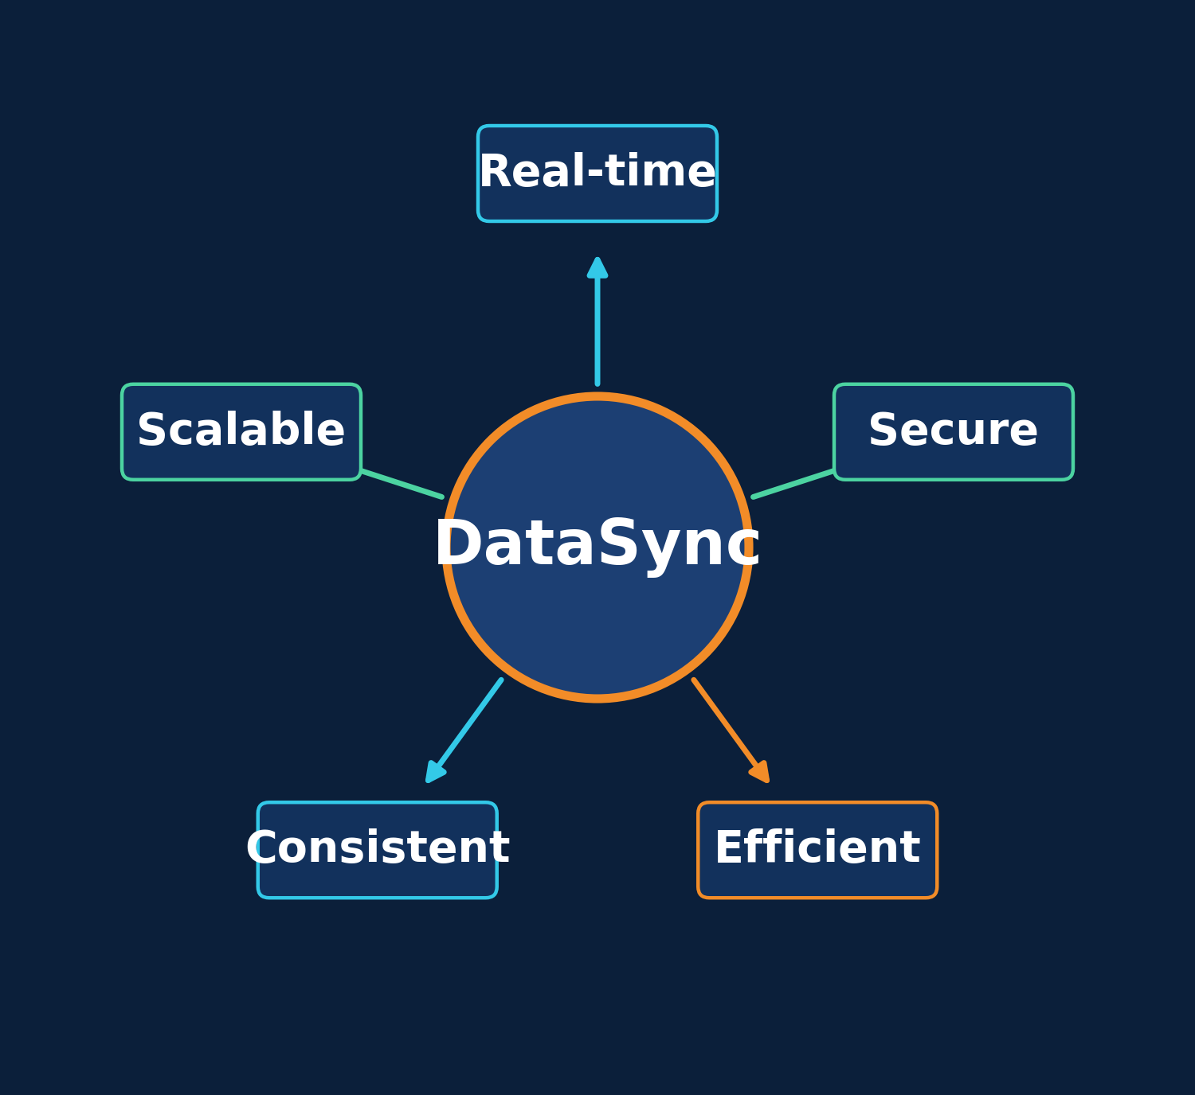
CONCLUSION
DataSync is an intelligent client-server data exchange platform that combines REST APIs, WebSockets, and delta synchronization to keep data consistent across all connected clients in real time. With secure JWT-based access, conflict resolution, and caching, it reduces bandwidth usage and latency compared with traditional polling, providing a reliable and scalable foundation for modern internet applications.

Slide 9
REFERENCES
1. R. T. Fielding, “Architectural Styles and the Design of Network-based Software Architectures,” Ph.D. dissertation, Dept. of Information and Computer Science, Univ. of California, Irvine, 2000.
2. I. Fette and A. Melnikov, “The WebSocket Protocol,” RFC 6455, Internet Engineering Task Force (IETF), Dec. 2011.
3. M. Jones, J. Bradley, and N. Sakimura, “JSON Web Token (JWT),” RFC 7519, Internet Engineering Task Force (IETF), May 2015.
4. M. Shapiro, N. Preguiça, C. Baquero, and M. Zawirski, “Conflict-free Replicated Data Types,” in Proc. Int. Symp. Stabilization, Safety, and Security of Distributed Systems (SSS), LNCS 6976, Springer, pp. 386–400, 2011.
5. M. Kleppmann and A. R. Beresford, “A Conflict-Free Replicated JSON Datatype,” IEEE Trans. Parallel Distrib. Syst., vol. 28, no. 10, pp. 2733–2746, 2017.

Slide 10
THANK YOU

